Slide 1

Chapter 8
Group data
Notes:
In this chapter grouping data will be explained

Slide 2
Content
When to group data?
How to group data?
Examples
Notes:
This chapter includes when and how we will use this structure followed by some examples

Slide 3

Example 1: why group data?
This shoe store has an alphabetical list of all the shoe brands they sell (from a database or a file).
On the website, brands are grouped by highlighting the first letter of the brand name.
Notes:
First example

Slide 4
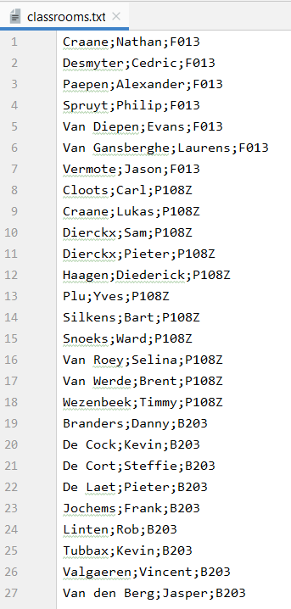

Example 2: why group data?
One of your colleagues made a file with the name of each student and the room where that student is taking the exam.
You want a List with the number of students per classroom.
Note: the records in the file are grouped by classroom (not ordered by room number!)
Notes:
Name, first name and the classroom

Slide 5
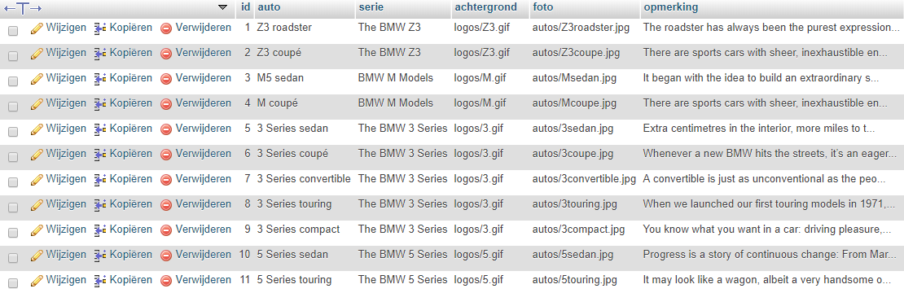
Example 3: why group data?
On the BMW website, all models (column car in database table) must be grouped by series (column series in database table).
car
series

Slide 6

Example 3: why group data?
Desired result

Slide 7
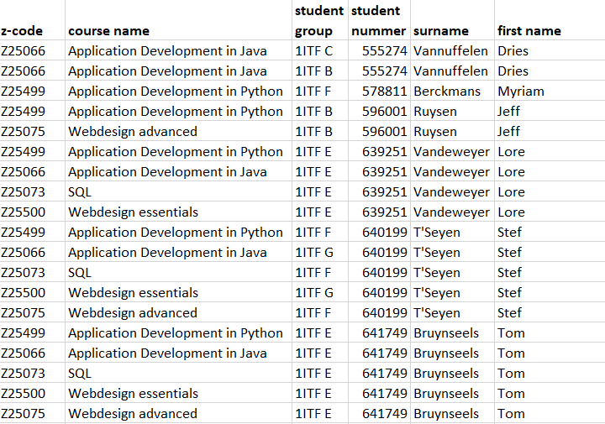
Example 4: why group data?
You have a file that contains all the courses that each student takes + the name of the class in which he is taking the course.
The list is grouped by student and there are as many rows as courses for each student.

Slide 8
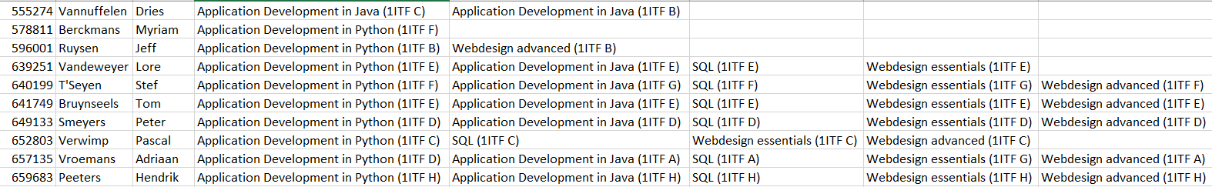
Example 4: why group data?
You want a new file with only one row per student.
Notes:
After using the structure data grouping the following result is created.
1 record per student is created

Slide 9
How to group data?
“Group data” is a programming technique that you can use if you
have access to a (large) amount of sorted data and you would like to group this data according to a certain criterion
know that after a group of data with the same 'key' comes another set. You want to keep the data of that group together and find exactly where the group stops.
This technique is often used when creating reports based on a sequential file, but is also often used in other situations (see previous examples).

Slide 10
How to group data?
program start instructions
while not_end_data:
group start instructions
while not_end_data and in_the same_group:
actions for that one element of the group
take next element of the group
group final instructions
program final instructions

Slide 11
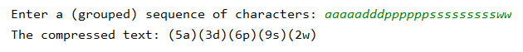
How to group data: example with string
Example:
The string contains 5 groups of characters. Each group is characterized by a character.
At the beginning of each (new) group we have to define this characteristic by a special variable, the "indicative". We use this as an indication as we walk further through the string.
At some point we will discover that the character we are reading no longer corresponds to this indicative. One group stops there and we have to start the next group.
a | a | a | a | a | d | d | d | p | p | p | p | p | p | s | s | s | s | s | s | s | s | s | w | w

Slide 12
How to group data: example with string
text = input('Enter a (grouped) sequence of characters: ') print('The compressed text: ', end='') i = 0 while i < len(text):
characterind = text[i] number_characters = 0
while i < len(text) and text[i] == characterind:
number_characters += 1 i += 1
print('('+str(number_characters)+characterind+')', end='') print()
program start instructions
while not_end_data:
group start instructions
while not_end_data and
in_the same_group:
actions
group final instructions
program final instructions

Slide 13
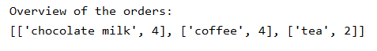
How to group data: example with List
We have a list that contains all the drinks that people ordered:
We want this new list as a result:
orders = ['chocolate milk', 'chocolate milk', 'chocolate milk', 'chocolate milk’,
'coffee', 'coffee', 'coffee', 'coffee', 'tea', 'tea']
Notes:
An example with a list named orders.
Result list overview with a summary of the ordered drinks.
Note the again the list is ordered based on the drinks (first all chocolate milk, next all coffee…)

Slide 14
How to group data: example with List
orders = ['chocolate milk', 'chocolate milk', …, 'tea', 'tea'] overview = [] counter = 0
while counter < len(orders):
drinkind = orders[counter] number = 0 while counter < len(orders) and orders[counter] == drinkind: number += 1 counter += 1 overview.append([drinkind, number]) print("Overview of the orders:") print(overview)
program start instructions
while not_end_data:
group start instructions
while not_end_data and
in_the same_group:
actions
group final instructions
program final instructions
Notes:
Start instructions: declaration of the list orders (square brackets) and initializing of the list overview
Again we need a counter to go through the loop
First loop will run as long we haven’t reached the end of the list. While not_end_data.
For each group we define the indicative or key, in our example the first element of the list (chocolate milk).
We also initialize a variable number to count the items of the drink (chocolate milk)
The second loop will run as long as we haven’t reached the end of the list and as long as we are processing items of the same group (chocolate milk).
We augment the variable number and counter with 1.
At the end of each group we add the indicative and the number of items of that group to the list overview.
Then we start with the second group coffee (becomes our second initiative, we initialize number) and we progress all coffee items. When we have reached the end of the list, the final program instructions are executed. Printing the result calculated in the list overview.

Slide 15
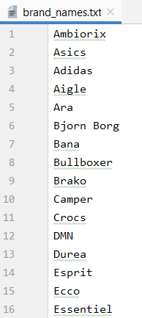
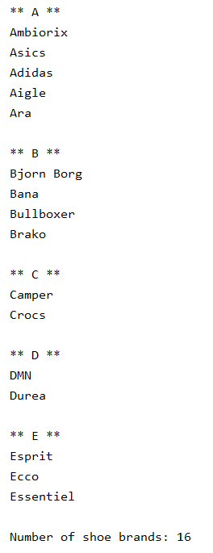
How to group data: example with file
We make this overview of the given text file with (shoe) brand names
Notes:
With this example we are going to solve the problem of the shoe shop. We start with the txt file brand_names which contains all shoe brands sold by the shop. Note the brand names are sorted alphabetically.
We want to create an overview with all brands starting with the letter A, secondly with the letter B and so on. At the end we print the number of brands that are sold by the shop.

Slide 16
How to group data: example with file
with open('brand_names.txt') as file: number_of_brands = 0 line = file.readline() while line: brandind = line[0] print("**", brandind, "**") while line and line[0] == brandind:
number_of_brands += 1 print(line, end='') line = file.readline() print() print("Number of shoe brands:", number_of_brands)
program start instructions
while not_end_data:
group start instructions
while not_end_data and
in_the same_group:
actions
group final instructions
program final instructions
Notes:
We start with the program instructions.
Open the file brand_names, we initialize a variable number_of_brands to count the number of brands available in the shoe shop.
We read the first line of the file.
While we haven’t reached the end of the file we process all items within the file (while line:)
We execute the group start instructions, define the key or indicative, first character of the first line, letter A, line[0], and we print the letter A captured by 2 asterix signs.
The second loop will run als long we haven’t reached the end of the file and as long as we are processing lines of the same group, brands starting with the letter A.
For each item we increase the number_of_brands, we print the name of the shoe brand and we read the next line in our file. When we have reached the end of the group we print a blank line and we start with the second group, letter B. Again the indicative is defined, and the letter is printed in the output screen, we now process all items with as first letter a B.
When we reach the end of the file the program final instructions are executed and we send the total number of brands to the output screen.

Slide 17

How to group data: example2 with file
With the information from the file we create a List with the number of students per classroom.
In the input file we will read line by line.
Each line is split up:
record[0] contains the surname
record[1] contains the first name
record[2] contains the classroom number
Notes:
The last example also starts from a file called classrooms.txt. Note the file is sorted by classroom, this is mandatory to group the data based on the classroom.
Each line contains the name, the first name of the student and the classroom where the exam is taken.
We want to create a list with the number of students within each classroom. So we read the input file line by line and we need to split up each line using the function split() which will create a list containing at index 0 the name, at index 1 the first name and at index 2 the classroom

Slide 18
How to group data: example 2 with file
room_list = [] with open('classrooms.txt') as file: line = file.readline().rstrip() record = line.split(';’)
while line: roomind = record[2] number_per_room = 0 while line and record[2] == roomind: number_per_room += 1 line = file.readline().rstrip() record = line.split(';') room_list.append([roomind, number_per_room]) print(room_list)
program start instructions
while not_end_data:
group start instructions
while not_end_data and
in_the same_group:
actions
group final instructions
program final instructions
Notes:
We start with the initializing of a new list room_list. We open the file to read each line.
We read the first line and remove the blanc at the end of that line. We split the line based on the semicolon (;)
While we haven’t reached the end of the file, we define the indicative of key, namely the room which we can find at index 2 within the list record.
We initialize the variable number_per_room to count the student per classroom.
As long as we haven’t reached the end of the file and we are still processing the same group (f013), we add 1 to the variable number_per_room, we read the next line and we split these line.
At the end of the group we append the indicative and the number of students per room to the list room_list.
We now process the next group P108 Z and so on, until we reach the end of the file. We now execute the program final instructions, and print the content of the room_list to the output screen.

